Slide 1
PCB Assembly

Slide 2
The PCB Assembly Process
Apply solder paste with a stencil
Place parts
Reflow in an oven
Solder on through-hole components.

Slide 3
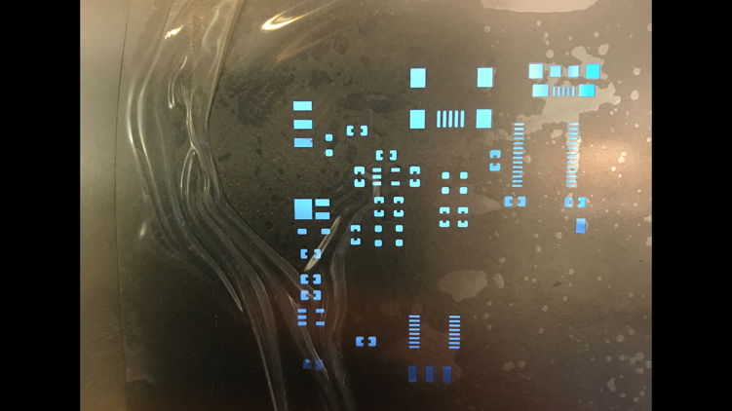
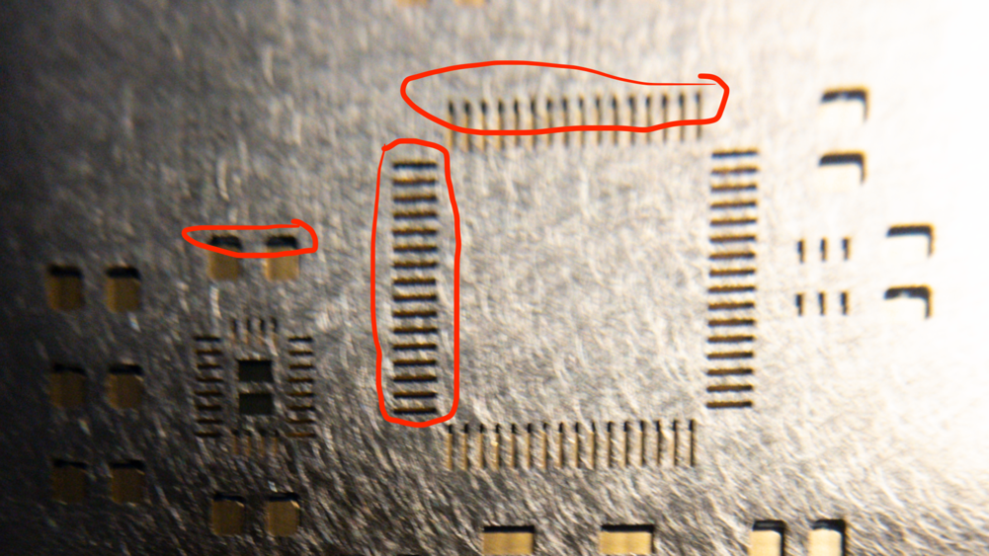
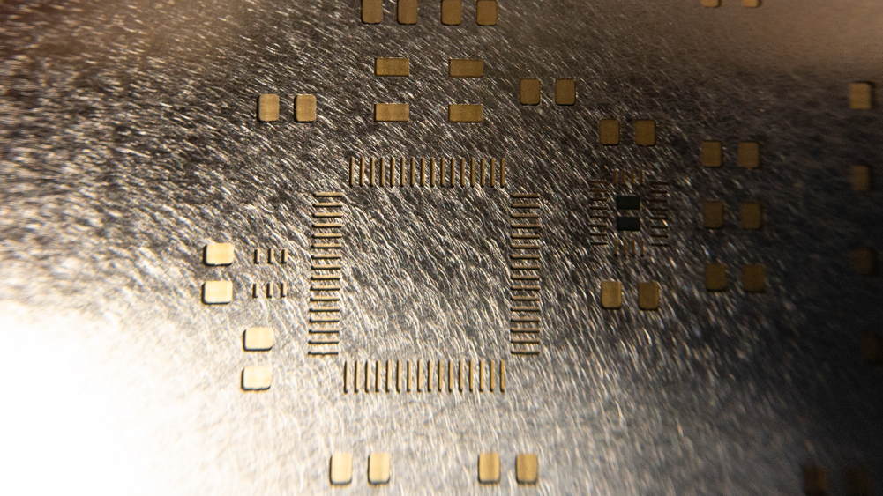
Align Stencil
Bad
Good

Slide 4
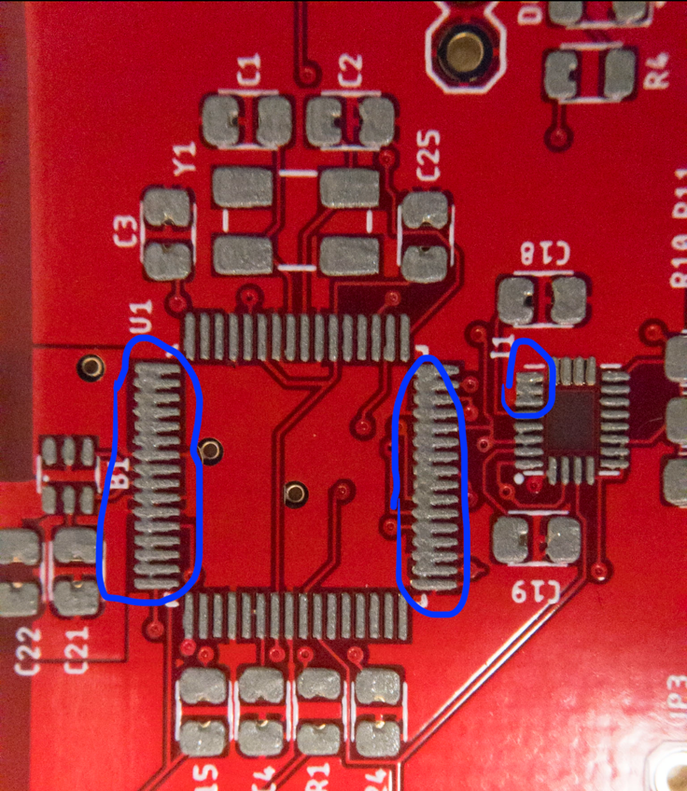
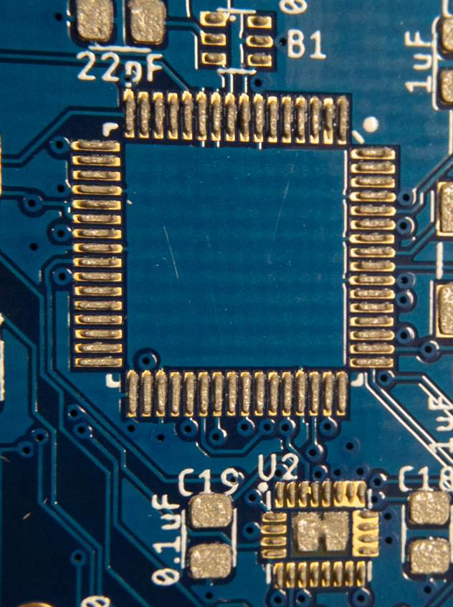
Applying Solder Paste
Bad
Good

Slide 5
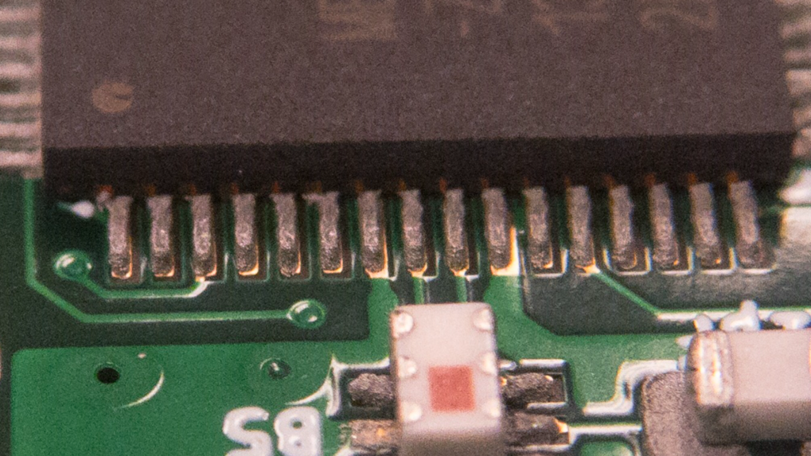
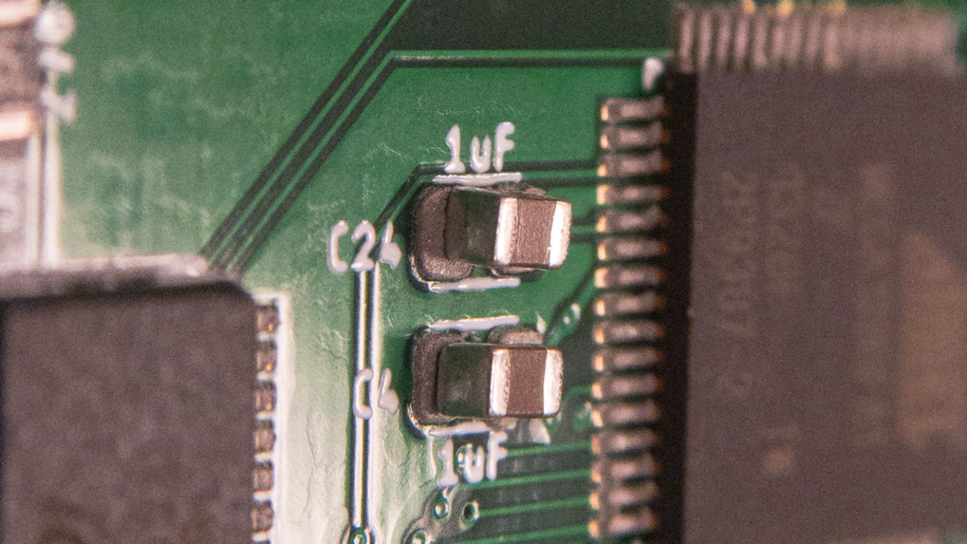
Part Placement
Good
Good

Slide 6
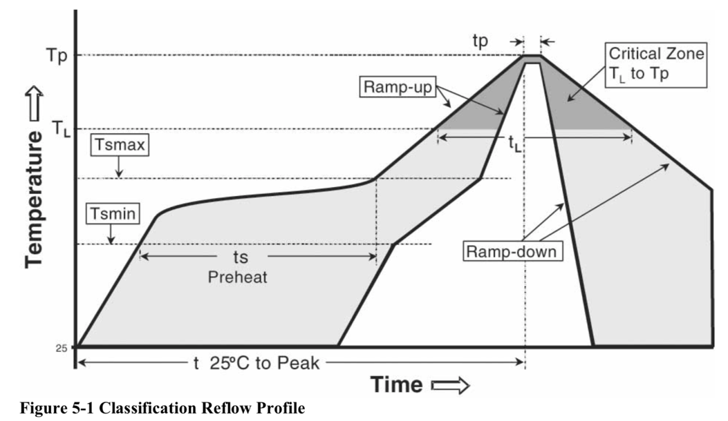
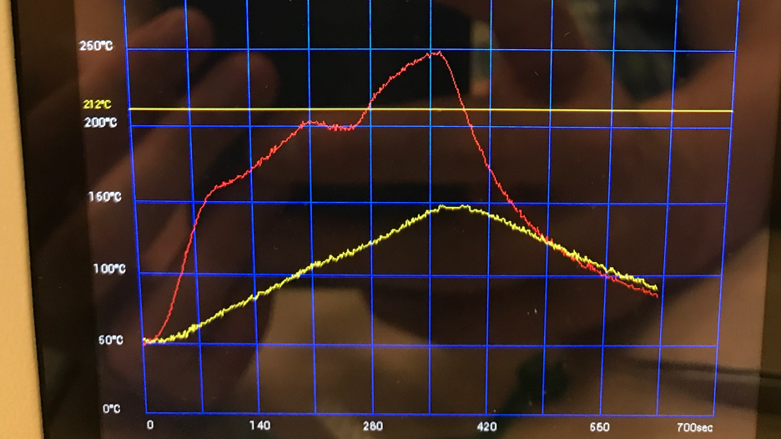
Reflow Soldering

Slide 7
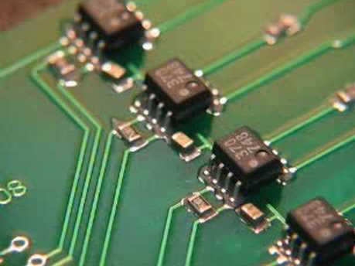
Reflow Video

Slide 8
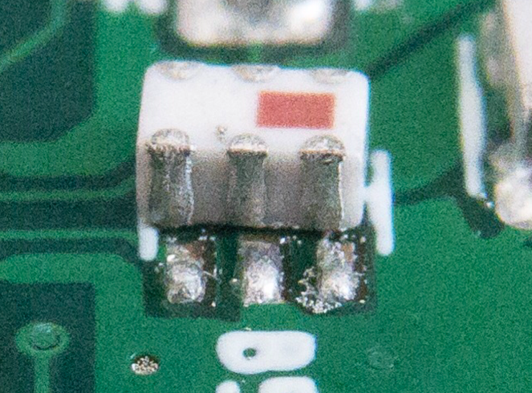
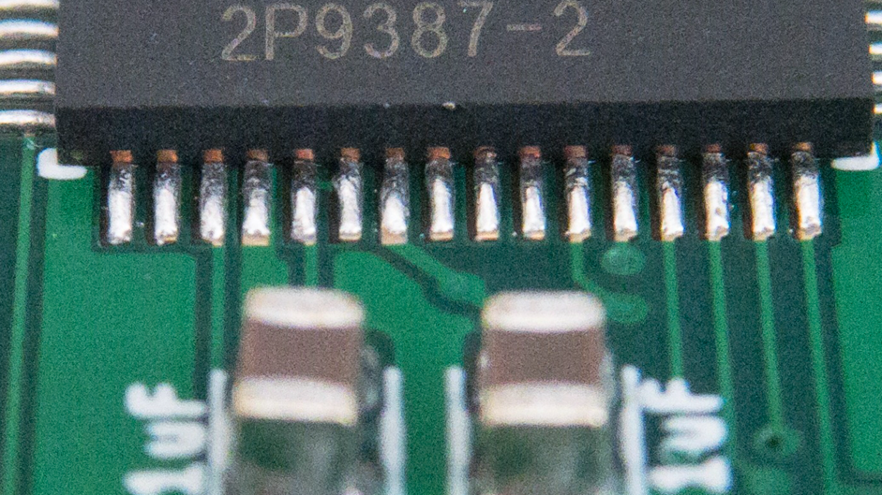
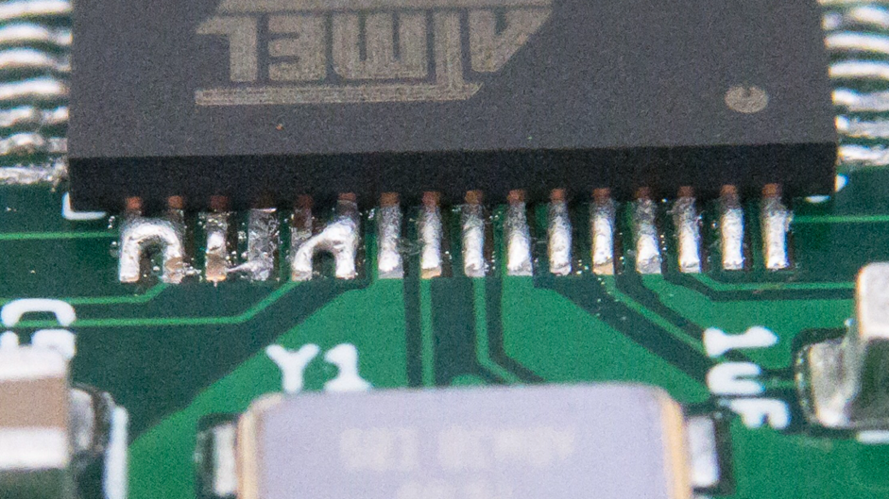
Reflow Soldering Results
Good
Bad

Slide 9
Solder Joints

Slide 10
TODO
Add slides for:
Flow chart/illustrations of assembly process.
Side view of board + paste + component.
Problems with IMU pads being in accessible.

Slide 11
Through-hole Video

